Slide 1

2021

Slide 2
Data Science and AI
Storytelling

Slide 3
Agenda
The importance of storytelling as a skill
A storytelling framework
Activity
Tips for effective delivery

Slide 4
The Importance of Storytelling as a Skill
Storytelling is an important interpersonal skill for data professionals. It helps them to be effective in job interviews and perform their roles as data or cyber security professionals.
It enables the communication of complex ideas, the contextual situation and conflicting elements of the decision making process.
Notes:
Stories are universal. We are all exposed to them from childhood and so everyone has listened to and told a story at some point
We are attuned to and have been swapping stories since the dawn of time
Hormones are released when feelings such as distress, engagement or empathy are experienced during a story
Since this is such a crucial method of communication, we should utilise it to achieve our objectives

Slide 5
The Importance of Storytelling as a Skill
The use of emotion makes it easier for the audience to remain attentive, retain information and create interest as opposed to being presented with a list of facts.
With good storytelling skills, a professional can gain buy-in from stakeholders, guide the agenda, influence decision making and ultimately achieve their objectives.
Notes:
Stories are universal. We are all exposed to them from childhood and so everyone has listened to and told a story at some point
We are attuned to and have been swapping stories since the dawn of time
Hormones are released when feelings such as distress, engagement or empathy are experienced during a story
Since this is such a crucial method of communication, we should utilise it to achieve our objectives

Slide 6
Discussion
Think of some of the best stories you have told or heard.
What are their main elements?
Who are some of the great storytellers?
What makes them effective?
Are there better ways of communicating complex ideas?

Slide 7

A Storytelling Framework
Theme
Setting
Character
Conflict
Plot
Notes:
AIM: To provide students with a simple memorable framework that they can remember and use throughout their career

Slide 8
Theme
What is your key message?
What are you trying to convey?
What’s the moral of the story?
Do you have examples of stories with a strong message?

Slide 9
Setting
Context
Background
History
Feelings and emotions

Slide 10

Character
Who is the Hero? You?
Stakeholders
What are their motivations, objectives, fears?

Slide 11
Conflict
Hero vs:
Someone else
Themselves
Technology
Society
Nature
What is causing the conflict?
Scarce resources
Competition
Regulation
Profitability
Survival

Slide 12
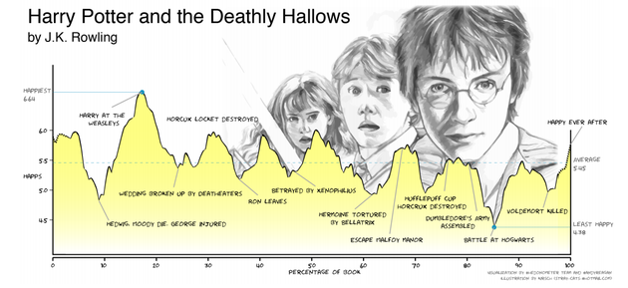
Plot
Exposition (Introduce themes, character and context of upcoming conflict)
Building tension and conflict
Climax!
Resolution and ending
Tension
Climax
Resolution
Conflict
Ending/Close
Exposition
Time
Notes:
The contrast between a narrative and a business presentation is that you don’t want to waffle.

Slide 13
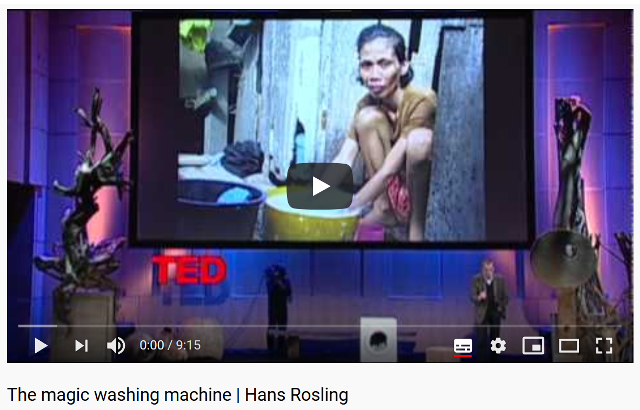
Case study
What makes the following compelling?
What are the theme, setting, character(s), conflict and plot?
https://www.youtube.com/watch?v=BZoKfap4g4w
Notes:
Theme - The washing machine is one of the most influential inventions of modern times Setting - 1950s Sweden to the present day Character - Hans’s mother and grandmother and more generally more than half the world’s women below the “wash line” Conflict - washing by hand is hard, time-consuming labour - there is a struggle for people to this day to afford a washing machine to free up this time for an improved lifestyle. Plot - Hans’s parents had been saving money for years to afford a washing machine - seeing it working for the first time gave a sense of wonder and “now we get to go to the library”

Slide 14
Activity
Tell a relevant story from your career
Stand up and tell a story with no preparation
Complete the Story Template from the next slide
Retell the same story to the class and receive feedback
Notes:
Students to present and receive feedback from instructors and other students.
Advise if a student is over-complicating their story, important to keep it simple.

Slide 15
Story Template
Section | Guiding Questions | Your Content
Theme | What are you trying to convey here?
Setting | What is the background and context on the situation?
Characters | Who are the key stakeholders and characters?
Conflict | What’s the problem?
Plot | What happened?

Slide 16
Communication skills
55% of communication is body language, 38% are the communication skills and 7% is the content.
Communication skills: Tone, Volume, Pitch, Rate of Speech, Pause. (from Vinh Giang, Communications coach)
It is helpful to engage your audience with questions and humour.
Notes:
The content won’t connect with the audience, it is your ability to induce emotion.
Music played by without emotion is just a series of notes, breath life in to your work because you are passionate about the imformation you are conveying and you believe it can impact others and businesses.
Frameworks to improve the delivery is to focus on communication skills and body language:
Tone – Are you direct and sharp with your words (highly impactful), or do you feel out the words (highly thoughtful)
Volume – Loud (commanding) or soft (personal)
Pitch – This is more for dynamics in presentation to engage, it’s great to impersonate characters to talk in 3rd person.
Rate of speech – Fast (engaging and energetic) or slow (thoughtful, easier to understand)
Pause – Pauses are essential as it builds emphasis and allows the audience to absorb what you’ve just said.

Slide 17

Body Language
Use hand/body gestures and facial expressions to match the emotions you are trying to elicit from the audience
Notes:
Body Language:
Use hand/body gestures and facial expressions to match the emotions you are trying to elicit from the audience
Ie if you want them to feel surprise, you act surprised.
- look surprised and startled(eyes wide open, mouth open)
- hands open
- body taken
E.g if you are staging the building the business problem, express your attitude towards the problem,
- is it frightening, astonishing or confusing?

Slide 18
Example: Vinh Giang
https://www.youtube.com/watch?v=MTY6Q31sIpQ
What are your thoughts about the content
He is clearly very engaging
Why?
How is he using the communication skills?
How is he using body language?
What emotions does he express through these skills?
Notes:
Combine the last two

Slide 19
Summary
Storytelling is an important skill for data professionals to engage stakeholders
We learnt a sample framework for effective delivery
Theme
Setting
Character
Conflict
Plot

Slide 20
Questions?

